Slide 1




GURSHAAN SINGH BHASIN
21BLC1424
BECM399J
INDUSTRIAL INTERNSHIP

Slide 2


INDUSTRY ADDRESS AND CONTACT PERSONS INFO
ADDRESS :
6th Floor, AKDR Tower, 4th Floor &, 3/381, Rajiv Gandhi Salai, Mettukuppam, Chennai, Tamil Nadu 600097
CONTACT DETAILS OF OUR INTERNSHIP MENTOR :
+91 89685 00480

Slide 3
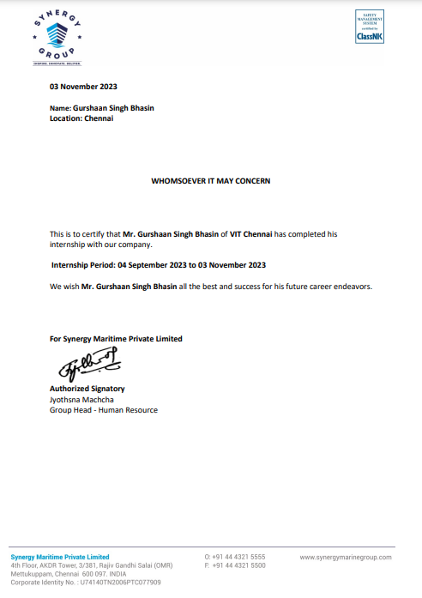
COMPLETION
CERTIFICATE

Slide 4

AGENDA OF THIS REPORT
ABOUT THE COMPANY
OBJECTIVES OF INTERNSHIP
CONCEPTS IN DEPTH
CONCLUSION

Slide 5
ABOUT THE COMPANY/BACKGROUND
As a leading shipmanager, the Synergy Group provides end-to-end maritime solutions with precisely and expertly tailored services, where great technical expertise and a diverse product portfolio create optimal efficiency, productivity and customer experience.
With over 660+ vessels under technical management they handle a wide variety of vessels, including complex LNG vessels, LNG-FSU conversions, LNG-to-power solutions, LPG carriers and chemical tankers, VLCCs, Suezmax, Aframax, LR2, LR1 and MR tankers, Car Carriers, container ships from 2,000 to 20,000 TEU and Cape, Kamsarmax, Panamax, Handymax and Handysize bulk carriers.
Close collaboration and clear communication are vital for the Synergy hallmarks of the best working relationships amid maritime solutions, long-term success, and through-life expertise.
Synergy prioritises each client’s needs, providing top quality and optimally efficient solutions, crafted to meet all requirements in management, building, converting, or recycling.

Slide 6
OBJECTIVES OF THE INTERNSHIP
To first understand the concept of Application Programming Interface (API)
Understand the Application of API’s by incorporating it in Code to import functionalities of the site whose API has been applied
Understanding File Sharing and Management Structures with regards to JSON formatted coding files
Implementation of all these concepts as a base , by incorporating them using Neo4j Graphical User Database System into code via API implementation and Query Processing through regular code for the same , with Visualization Options through the Site itself.

Slide 7
CONCEPTS IN DEPTH :
APPLICATION PROGRAMMING INTERFACE
APIs, or Application Programming Interfaces, serve as intermediaries that enable different software applications to communicate and interact with each other. They define the rules, protocols, and tools for exchanging information and accessing functionality. APIs find widespread use across various domains, facilitating integration between systems, platforms, and services.
Their versatility makes APIs invaluable in modern software development. Developers leverage APIs to incorporate functionalities from existing systems into their own applications without needing to understand the internal complexities. This accelerates development cycles, fosters innovation, and enhances the overall user experience. Additionally, APIs promote interoperability, allowing disparate systems to seamlessly exchange data and services, thereby fostering collaboration and integration in the digital ecosystem. In essence, APIs democratize access to technology and empower developers to create more sophisticated and interconnected software solutions.

Slide 8
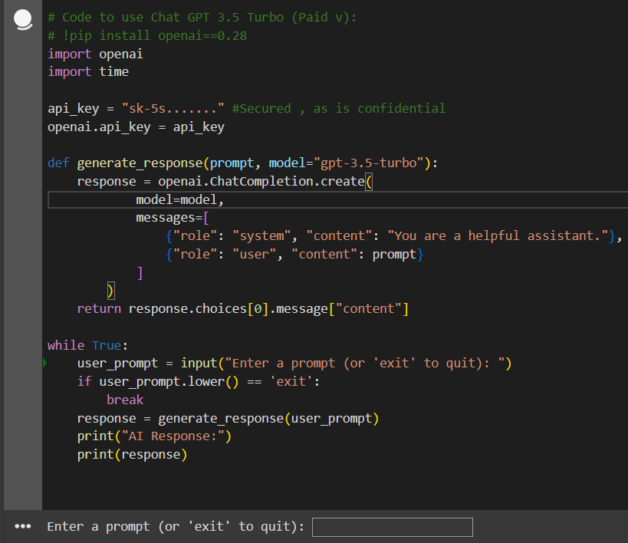
CONCEPTS IN DEPTH :
INCORPORATION OF API IN CODES
To understand the basic implementation of API into codes , we undertook the API of GPT v 3.5 (Only Paid v allows this) and created a basic Python code on Jupiter that asks user for a prompt or Question and then fetches the Answer from GPT , as its API has been called , here is the snippet of how the code looks [The key has been hidden due to confidentiality constraints]

Slide 9
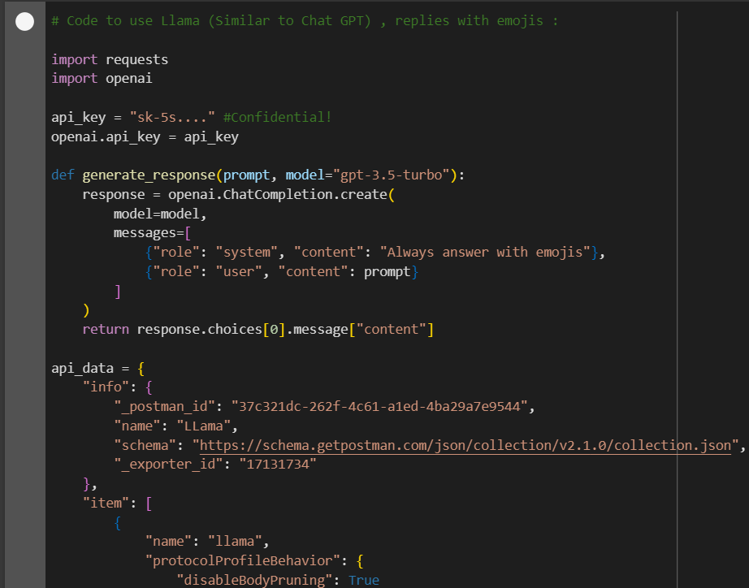
CONCEPTS IN DEPTH :
INCORPORATION OF API IN CODES
We also incorporated gpt v3.5 using Llama and gpt 3.5 incorporated together and to simply add a twist to it , made it so that it replies only using Emojis.
Thus , if I were to prompt , Tell me about the Moon , it would return all emoji’s that are related to the Moon , be it the different eclipses , phases of the moon or any other such related emoji. Of course the key is now closed off to us and is confidential , however here is the code that incorporates it

Slide 10
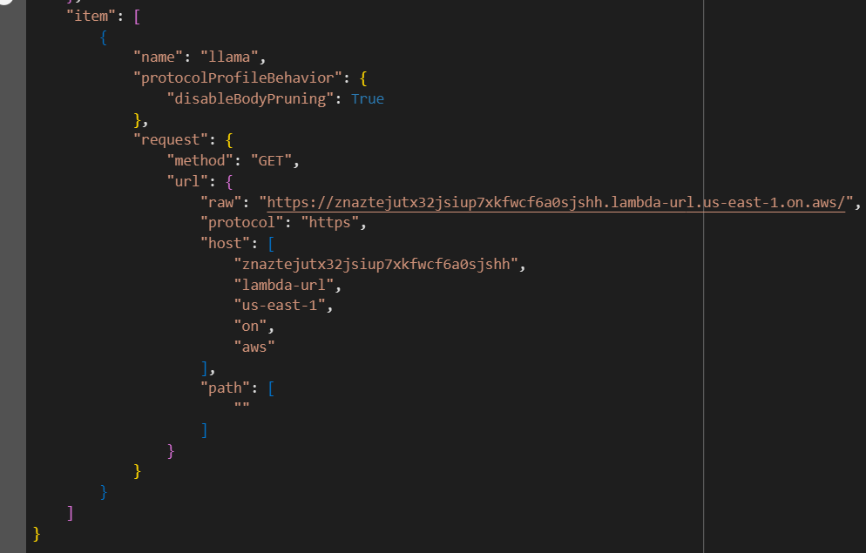
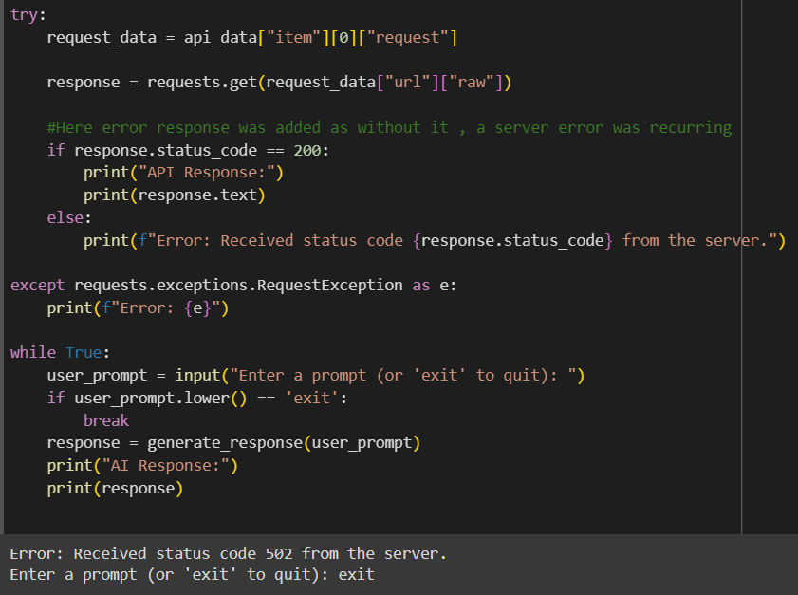
CONCEPTS IN DEPTH :
INCORPORATION OF API IN CODES

Slide 11
CONCEPTS IN DEPTH :
JSON FILE FORMAT
JSON (JavaScript Object Notation) is a lightweight data-interchange format widely used for transmitting data between a server and a web application. Its simplicity and human-readable structure make it a popular choice for sharing data across different programming languages and platforms. JSON consists of key-value pairs enclosed in curly braces {}, where keys are strings followed by corresponding values, which can be strings, numbers, arrays, objects, booleans, or null. Its uses span from transmitting data over HTTP requests in web APIs to configuring settings in web applications and storing data in databases. JSON's versatility, ease of use, and compatibility with various programming languages have made it a cornerstone in modern data exchange and communication between software systems.
Thus even in the second example of API application , you would have noticed the formatting to be different from the initial more basic .py structure , this is because we had incorporated the JSON Structure of the code , which allowed much more efficient sharing of the file between users irrespective of their platform, as per requirement. This is because it broke down the different segments of the code into various {} parts , being “info” that stored the basic address for Llama , “item” that stored the definition of the item we aim to obtain and lastly “request” that actually pulls/gets the requested item from our applied API defined in info.

Slide 12
CONCEPTS IN DEPTH :
NEO4J GRAPHICAL DATABASE
Neo4j is a graph database management system designed to store, retrieve, and manage data represented as nodes, relationships, and properties. Unlike traditional relational databases, Neo4j's graph structure allows for flexible and efficient querying of complex, interconnected data. Nodes represent entities, relationships define connections between nodes, and properties provide additional information about nodes and relationships.
Using Neo4j's API, developers can interact with the database programmatically, integrating graph-based functionalities into their applications. This API enables developers to perform operations such as creating, updating, and querying graph data using programming languages like Java, Python, or JavaScript. By leveraging the API, developers can harness Neo4j's powerful graph capabilities within their applications, facilitating tasks such as recommendation systems, social network analysis, and real-time network visualization. Overall, Neo4j's API empowers developers to build sophisticated applications that leverage the advantages of graph databases, including flexible data modeling, efficient traversal of relationships, and powerful graph algorithms.

Slide 13
CONCEPTS IN DEPTH :
NEO4J GRAPHICAL DATABASE
We had worked extensively for the greater part of the month on various concepts which are :
Understanding Basic Neo4j Graph creation and working on it using CYPHER language which is native to the DB.
Incorporating API of Neo4j , by defining the Instances key and passwords into our py codes
Generating CYPHER Queries through the py code which allows modifications into the Neo4j Database with the help of the API
Fetching results through the Code Terminal based on the information in the Database present , using the CYPHER Queries incorporated within the code
Working with real time Ship Data to create a recommendation system based on key-Value Pair generation by keeping a count on repeated searches of the user and storing a count of this paired search , then saving this count so that when the user next queries a keyword its highest count value pair is recommended as the next Question along with its answer stored and ready to be displayed.

Slide 14
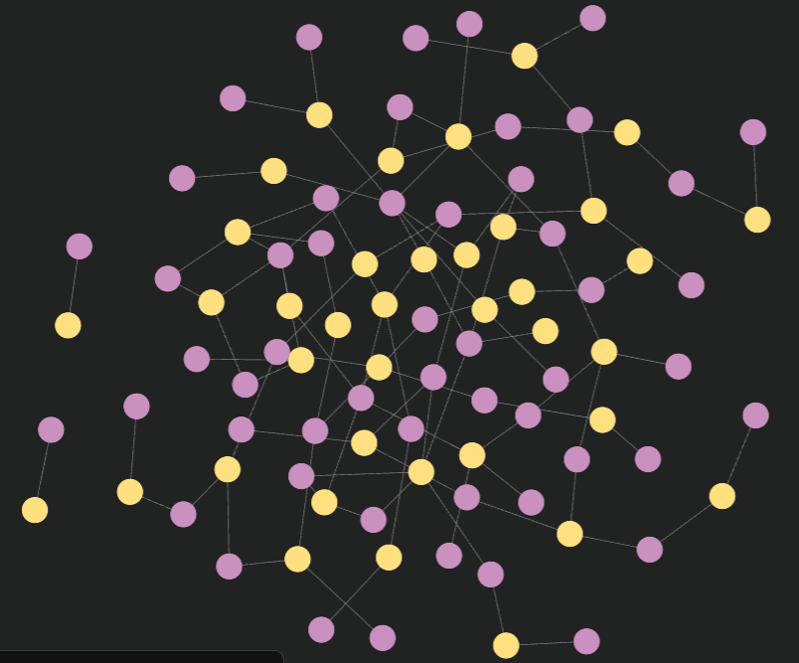
CONCEPTS IN DEPTH :
NEO4J GRAPHICAL DATABASE
Here is an example of basic Graph Creation and incorporation in py code along with how CYPHER Queries can be utilized to attain outputs from the Graphs formed from the Inputted Data in Question .
Alongside is how the Graph is made for Data comprising of Order details and Product Details to explain how the Neo4j Database works

Slide 15
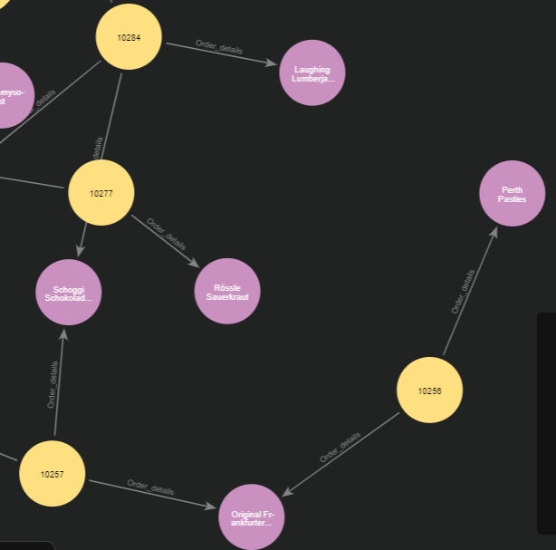
CONCEPTS IN DEPTH :
NEO4J GRAPHICAL DATABASE
When zoomed in , here is how it looks to show the Nodes Products and Orders along with the relationship called Order_Details defined between them :

Slide 16
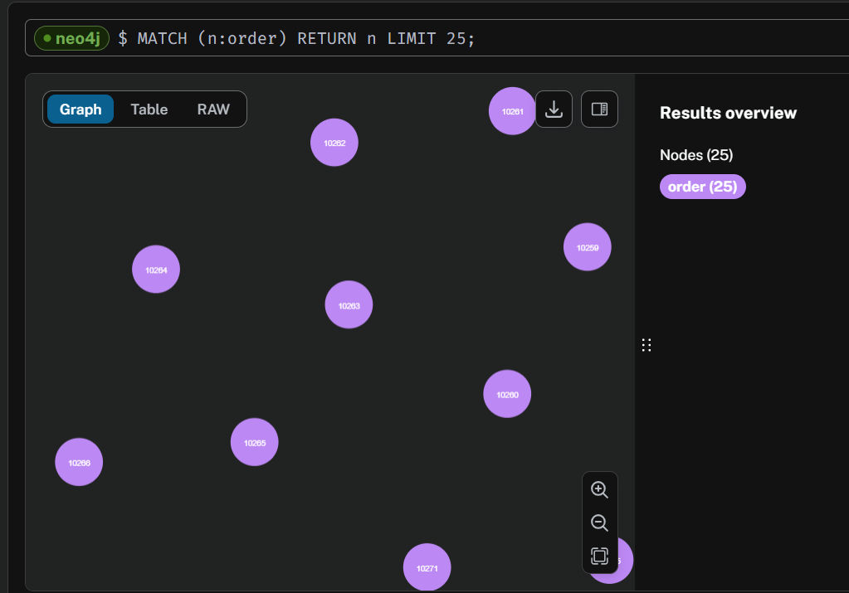
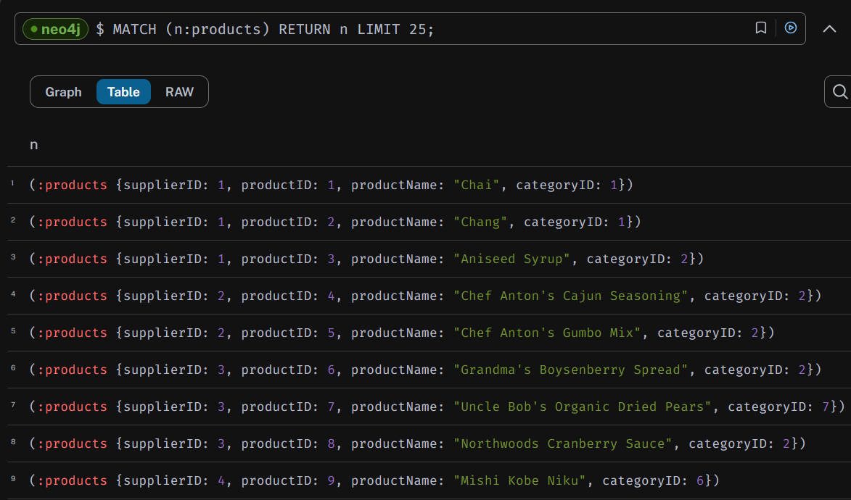
CONCEPTS IN DEPTH :
NEO4J GRAPHICAL DATABASE
We can also view all Order nodes and all Product Nodes in specific if we wished to , with a defined limit in this case as there are about 30+ products and 600+ orders in this database originally in graph , table or RAW form.

Slide 17
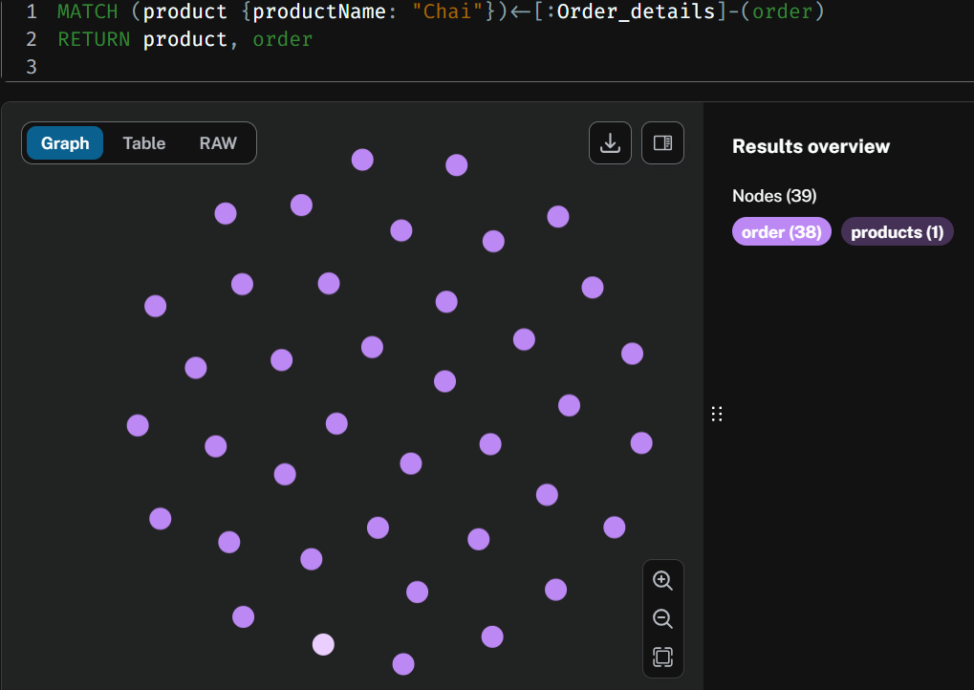
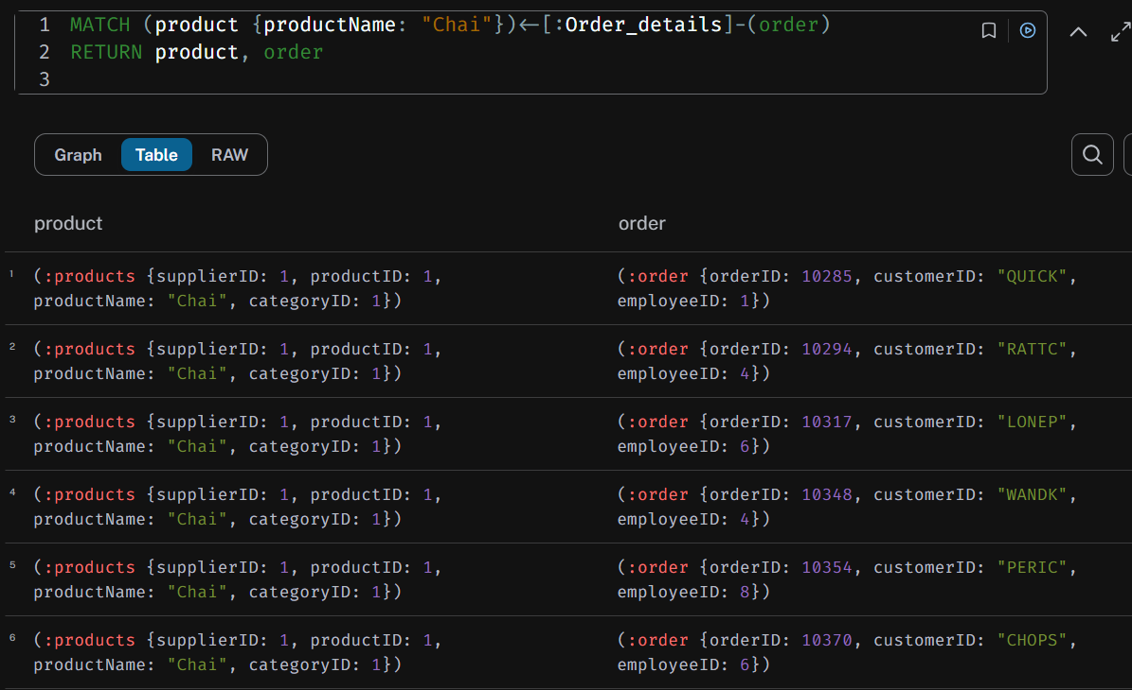
CONCEPTS IN DEPTH :
NEO4J GRAPHICAL DATABASE
If we were to try and find the Order details of a specific Product as well , we could do so by specifying them while creating our Cypher Query. So if we were to find all Orders that ordered the product “Chai” :

Slide 18
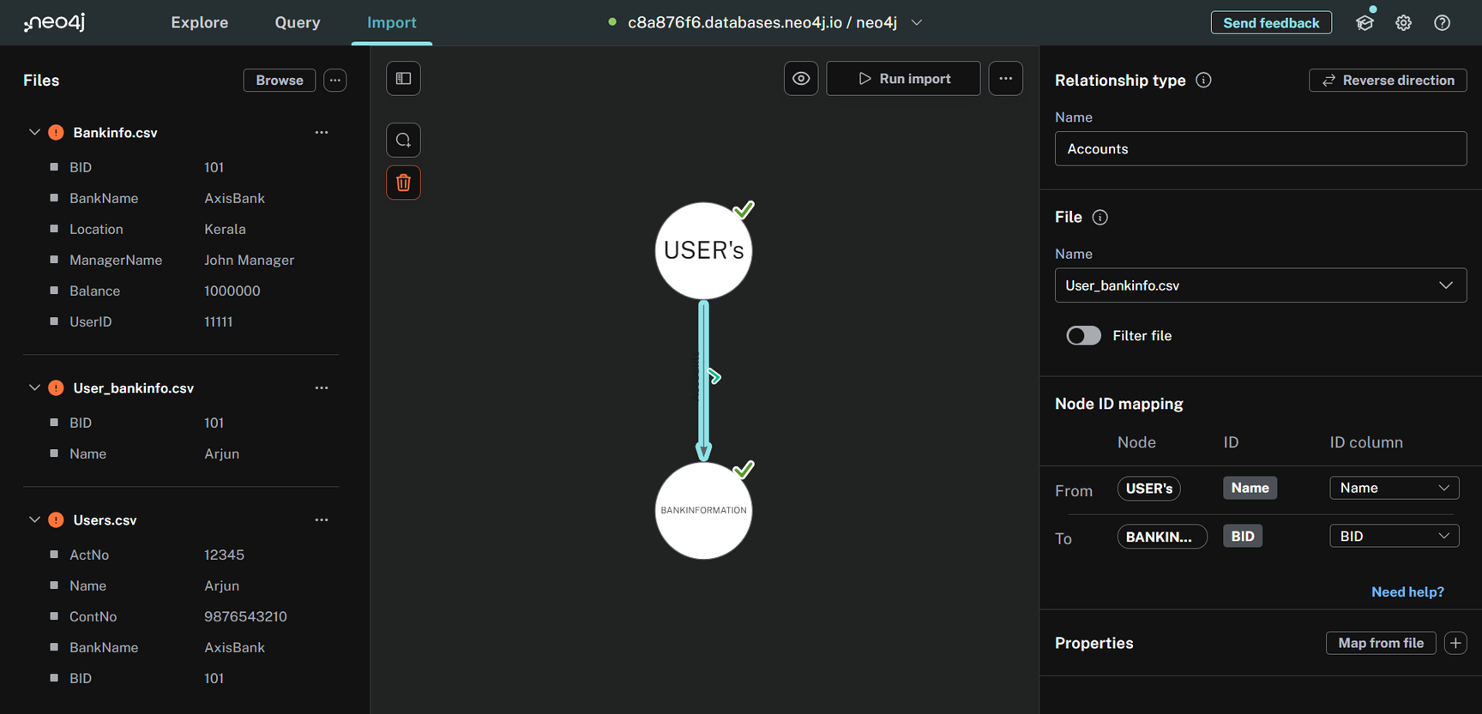
CONCEPTS IN DEPTH :
NEO4J GRAPHICAL DATABASE
Neo4j also has the utility of creating a DB on its own from CSV Files that can be uploaded by your own preferences , then they can be worked on them similarly. Heres an example of how , by uploading Users , BankInformation and Accounts csv’s where Accounts holds values for relationship between the 2 nodes the same way as how in MySQL or SQL+ in DBMS , we create a Primary Key and Foreign Key for data

Slide 19
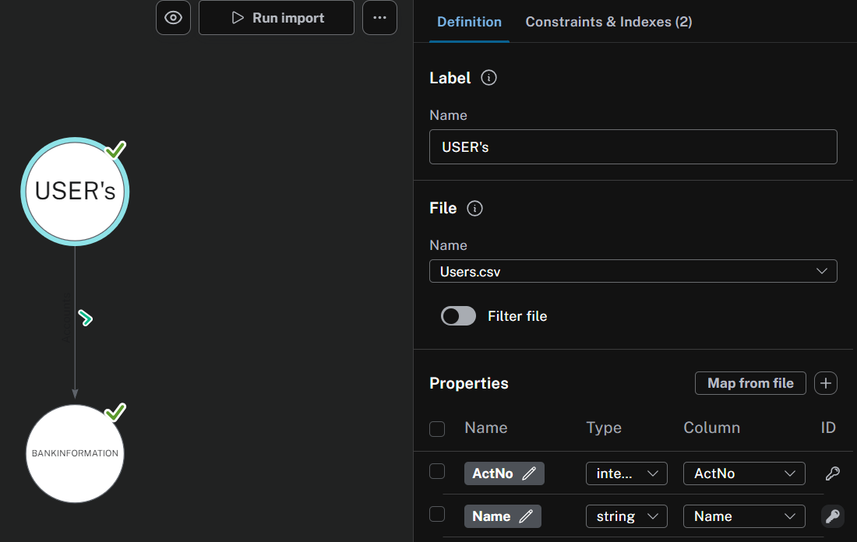
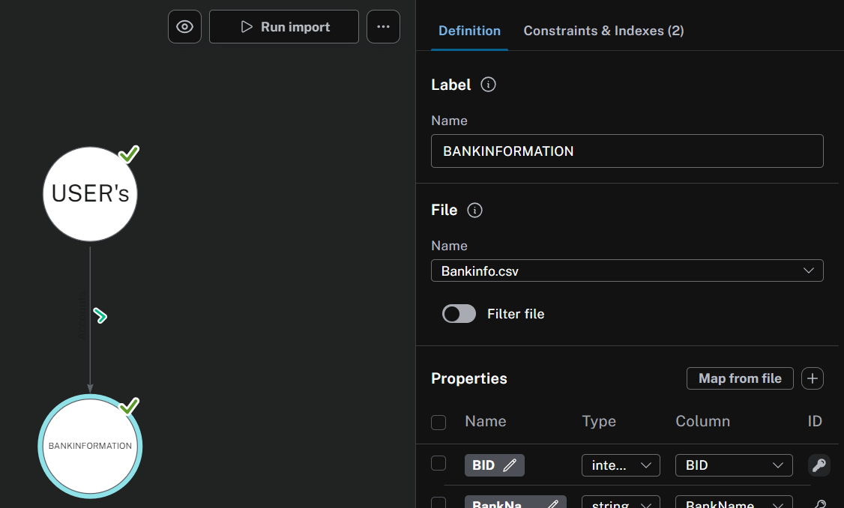
CONCEPTS IN DEPTH :
NEO4J GRAPHICAL DATABASE
In the picture earlier we defined which 2 attributes connect the nodes in the Relationship , this can be done by defining the Primary Keys done so :

Slide 20
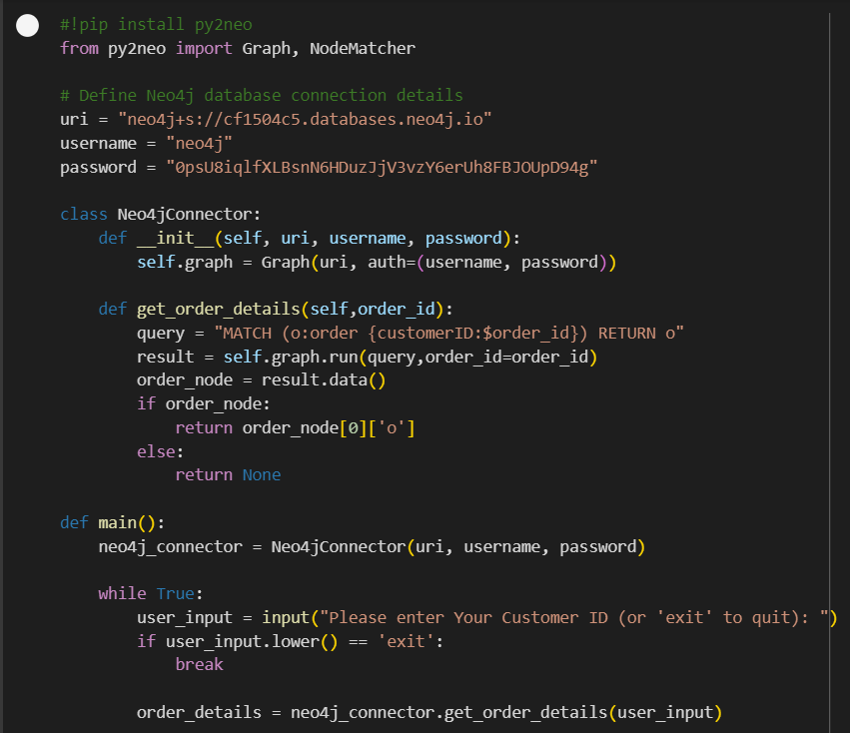
CONCEPTS IN DEPTH :
NEO4J GRAPHICAL DATABASE
Here are codes to how we can also connect this database using py code and neo4j API to then retrieve data from the Graph directly from our codes themselves. This makes working on a DB much easier compared to the conventional creation as CSV’s can be directly imported and graphs created for a beautiful visualization and retrieval through Cypher Codes within the Site itself or any other platform via API.

Slide 21
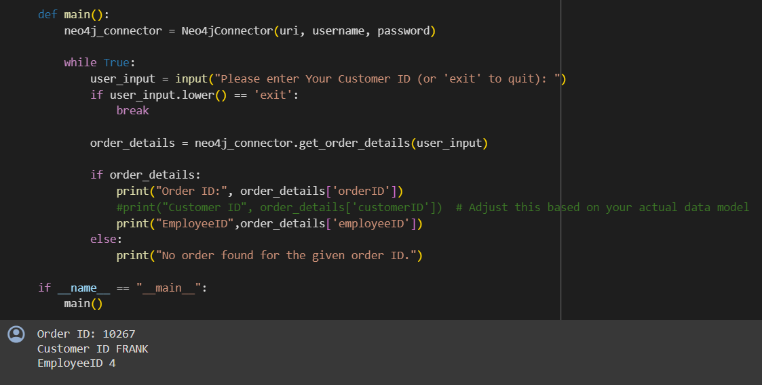
CONCEPTS IN DEPTH :
NEO4J GRAPHICAL DATABASE
So here is how the user was prompted was to enter OrderID and from the DB in Neo4j , its corresponding Customer ID and EmpID was returned. This is just a minor example to show the utility of the connection between code and DB through the API and DB connection , which can be scaled as per the users requirement in the future.

Slide 22
CONCLUSION
THUS OVERALL WE LEARNT THESE CONCEPTS CLEARLY AND THEIR IMPLEMENTATIONS :
API’s
Implementation of API’s in regular codes
JSON format file transfers and coding
Neo4j Graphical Database
Incorporation of Neo4j in Regular Code using API
Thank you Synergy Maritime for this wonderful opportunity that left me with memories and teachings of a lifetime to apply in my future academic endeavours.

